Slide 1
Miller

Slide 5
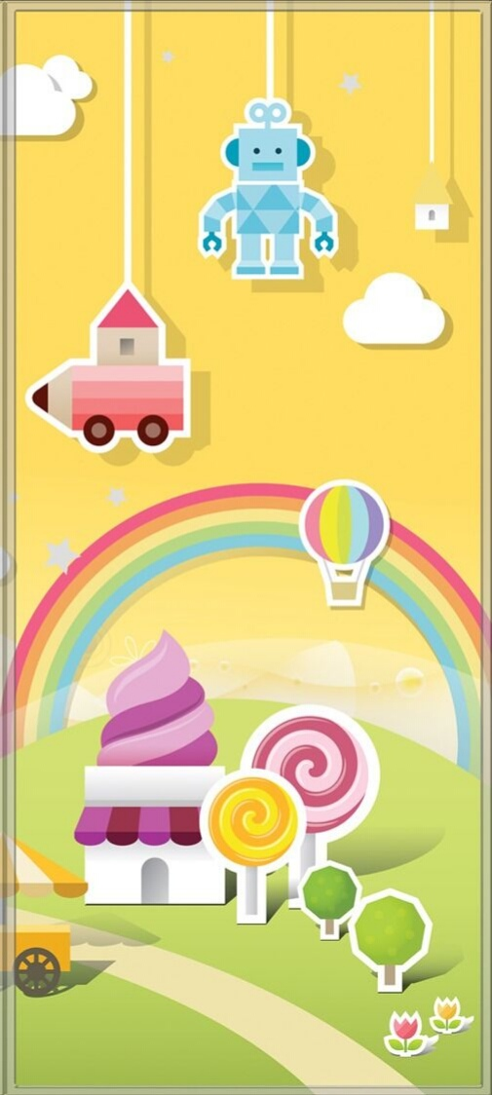
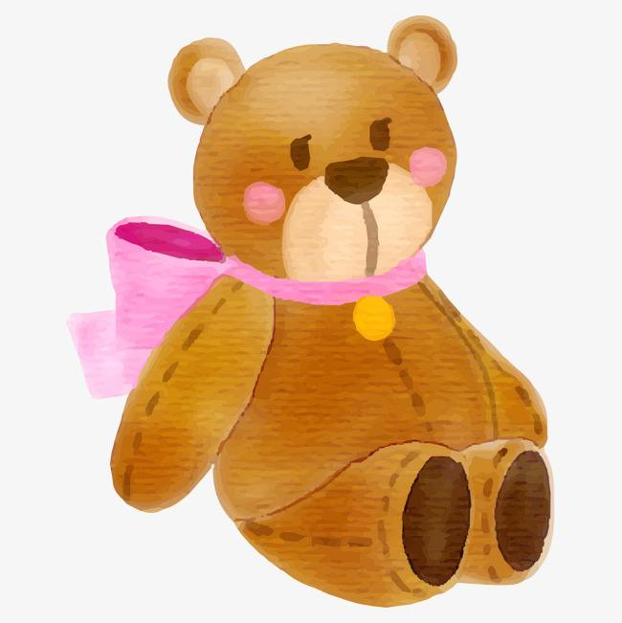

Slide 6
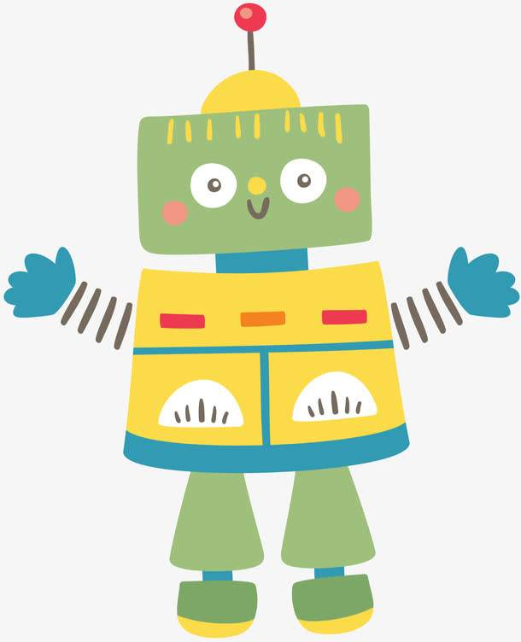
robot

Slide 7
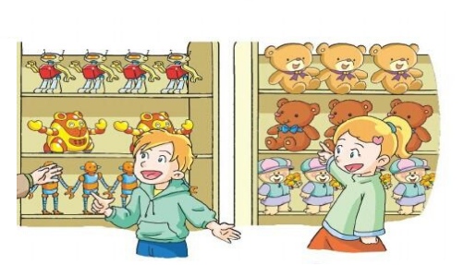
I like toy bears.
I like robots.

Slide 8
toy bear

Slide 10
ball

Slide 11
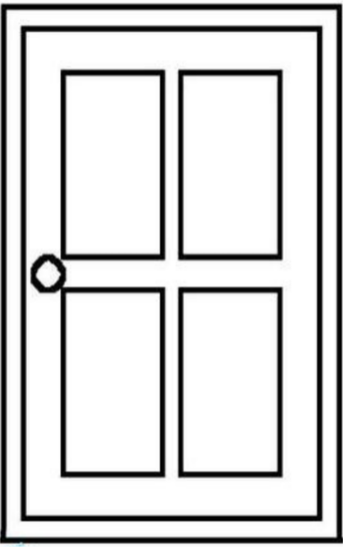

Slide 12
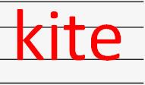

Slide 13
Ability path

Slide 14
Robot robots .
What do you like ?
I like robots .
Toy bear toy bears.
What do you like ?
I like toy bears.
Ball balls .
What do you like ?
I like balls .
Kite kites .
What do you like ?
I like kites.
They are fun! I love them!

Slide 15
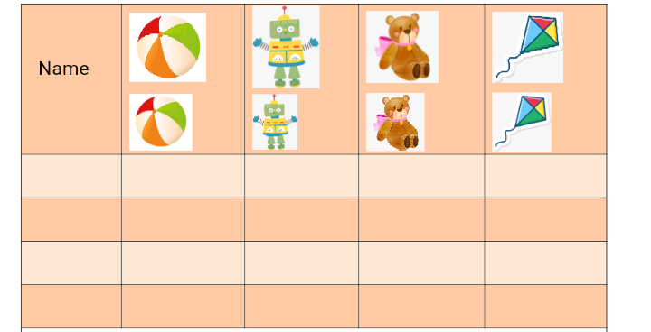
1. Do a survey , fill in the name and put a tick.
2. Draw your favorite toys and share it with your friends.

